Slide 1
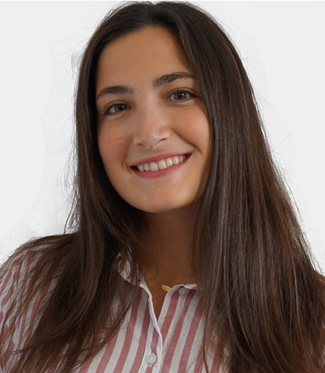
Laboratory 08
Transfer Learning
Laia Tarrés
laia.tarres@bts.tech
MsC Student
UPCTech -> Researcher at BBC & IRI

Slide 2
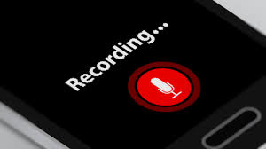
Reminder
Is this webinar being recorded?

Slide 3
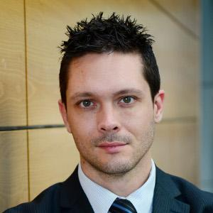



Acknowledgements
Kevin McGuinness
kevin.mcguinness@dcu.ie
Research Fellow
Insight Centre for Data Analytics
Dublin City University
Ramon Morros
ramon.morros@upc.edu
Associate Professor
ETSETB TelecomBCN
Universitat Politècnica de Catalunya

Slide 4
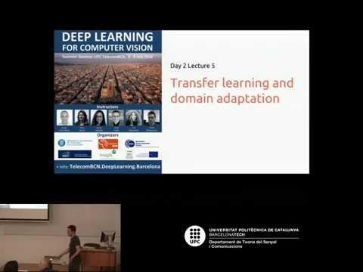
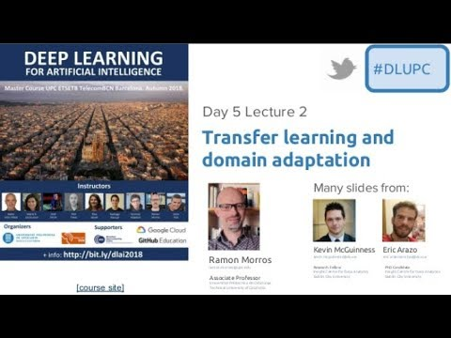
Videolectures
Kevin McGuinness (UPC DLCV 2016)
Ramon Morros (UPC DLAI 2018)

Slide 5
Transfer learning: the motivation
In many cases, not enough training data is available to estimate the large amount of parameters required by a deep neural network.

Slide 6
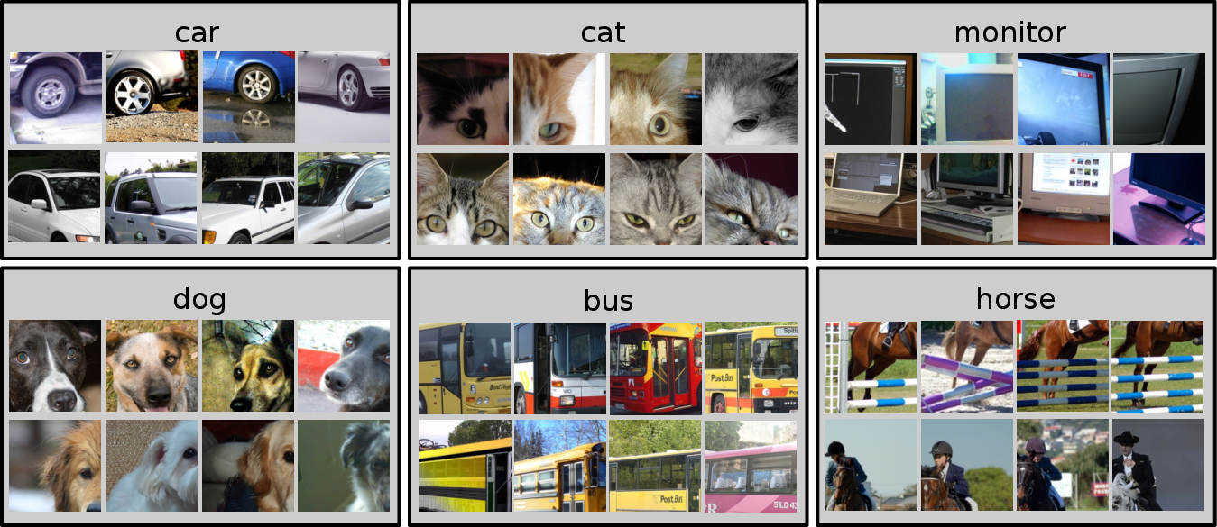
Example: PASCAL VOC 2007
Standard classification benchmark, 20 classes, ~10K images, 50% train, 50% test
Deep networks can have many parameters (e.g. 60M in Alexnet)
Direct training (from scratch) using only 5K training images can be problematic. Model overfits.
How can we use deep networks in this setting?

Slide 7
Transfer learning: the solution
Instead of training a deep network from scratch for your task:
Take a network trained on a different domain for a different source task
Adapt it for your domain and your target task

Slide 8
Transfer learning: idea
Source labels
Target labels
Small amount of data/labels
Large amount of data/labels
Source model
Transfer Learned Knowledge
Target model
Source data
E.g. ImageNet
Target data
E.g. PASCAL

Slide 9

“Off-the-shelf”
Idea: use outputs of one or more layers of a network trained on a differen task as generic feature detectors. Train a new shallow model on these features.
loss
Shallow classifier (e.g. SVM)
softmax
features
fc2
fc1
fc1
conv3
TRANSFER
conv3
conv2
conv2
conv1
conv1
Data and labels (e.g. ImageNet)
Target data and labels

Slide 10
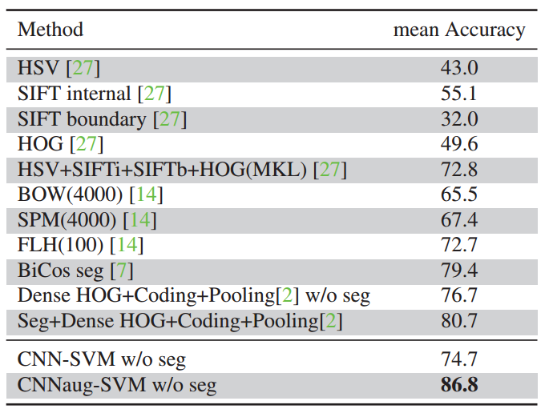
Off-the-shelf features
Works surprisingly well in practice!
Surpassed or on par with state-of-the-art in several tasks in 2014
Image classification:
PASCAL VOC 2007
Oxford flowers
CUB Bird dataset
MIT indoors
Image retrieval:
Paris 6k
Holidays
UKBench
Oxford 102 flowers dataset
Razavian et al, CNN Features off-the-shelf: an Astounding Baseline for Recognition, CVPRW 2014 http://arxiv.org/abs/1403.6382

Slide 11
Can we do better than off the shelf features?

Slide 12
Fine-tuning: supervised task adaptation
Train deep net on “nearby” task for which it is easy to get labels using standard backprop
E.g. ImageNet classification
Pseudo classes from augmented data
Slow feature learning, ego-motion
Cut off top layer(s) of network and replace with supervised objective for target domain
Fine-tune network using backprop with labels for target domain until validation loss starts to increase
surrogate loss
real loss
fc2 + softmax
my_fc2 + softmax
fc1
conv3
conv2
conv1
surrogate data
labels
real data
real labels

Slide 13
Freeze or fine-tune?
LR > 0
loss
Bottom n layers can be frozen or fine tuned.
Frozen: not updated during backprop
Fine-tuned: updated during backprop
Which to do depends on target task:
Freeze: target task labels are scarce, and we want to avoid overfitting
Fine-tune: target task labels are more plentiful
In general, we can set learning rates to be different for each layer to find a tradeoff between freezing and fine tuning
fc2 + softmax
Fine tuned
fc1
conv3
frozen
conv2
conv1
LR = 0
data
labels

Slide 14
Summary
Possible to train very large models on small data by using transfer learning and domain adaptation
Off the shelf features work very well in various domains and tasks
Lower layers of network contain very generic features, higher layers more task specific features
Supervised domain adaptation via fine tuning almost always improves performance

Slide 15
The Lab

Slide 16

Today’s objectives
Tricks when working with small dataset
Training network from scratch with and without data augmentation
Using pretrained network just to extract features
Using pretrained network and finetune it

Slide 17
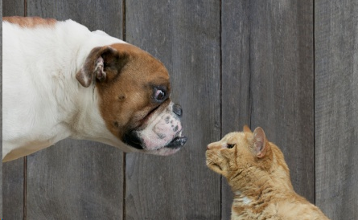
Cats vs Dataset
Cats vs. Dogs dataset
Binary Classification between cats and dogs
Does not come packaged with PyTorch

Slide 18


Kick off the lab
Launch a web browser (Chrome recommended).
Login to a Google account. Create a new one if preferred.
Open this notebook, create a copy in your own Drive, and open the copy.
Optional: Change runtime type to work with GPU.

Slide 19
